Slide 1
Decision Trees
Decision tree representation
Entropy, information gain

Slide 2
Introduction
Goal: Categorization
Given an event, predict is category. Examples:
  Who won a given ball game?
  How should we file a given email?
  What word sense was intended for a given occurrence of a word?
Event = list of features. Examples:
  Ball game: Which players were on offense?
  Email: Who sent the email?
  Disambiguation: What was the preceding word?

Slide 3
Introduction
Use a decision tree to predict categories for new events.
Use training data to build the decision tree.
New
Events
Training
Events and
Categories
Decision
Tree
Category

Slide 4
Decision Tree for PlayTennis
Outlook
Sunny
Overcast
Rain
No
No
Humidity
Each internal node tests an attribute
High
Normal
Each branch corresponds to an
attribute value node
No
Yes
Each leaf node assigns a classification

Slide 5
Word Sense Disambiguation
Given an occurrence of a word, decide which sense, or meaning, was intended.
Example: "run"
  run1: move swiftly (I ran to the store.)
  run2: operate (I run a store.)
  run3: flow (Water runs from the spring.)
  run4: length of torn stitches (Her stockings had a run.)
  etc.

Slide 6
Word Sense Disambiguation
Categories
  Use word sense labels (run1, run2, etc.) to name the possible categories.
Features
  Features describe the context of the word we want to disambiguate.
  Possible features include:
    near(w): is the given word near an occurrence of word w?
    pos: the word’s part of speech
    left(w): is the word immediately preceded by the word w?
    etc.

Slide 7
Word Sense Disambiguation
Example decision tree:
(Note: Decision trees for WSD tend to be quite large)
pos
noun
verb
near(stocking)
near(race)
yes
no
yes
no
run4
run1
near(river)
yes
no
run3

Slide 8
WSD: Sample Training Data
Features |  |  |  | Categories
pos | near(race) | near(river) | near(stockings)
noun | no | no | no | run4
verb | no | no | no | run1
verb | no | yes | no | run3
noun | yes | yes | yes | run4
verb | no | no | yes | run1
verb | yes | yes | no | run2
verb | no | yes | yes | run3

Slide 9
Decision Tree for Conjunction
(Outlook=Sunny) ∧ (Wind=Weak)
Outlook
Sunny
Overcast
Rain
Wind
No
No
Strong
Weak
No
Yes

Slide 10
Decision Tree for Disjunction
(Outlook=Sunny) ∨ (Wind=Weak)
Outlook
Sunny
Overcast
Rain
Yes
Wind
Wind
Strong
Weak
Strong
Weak
No
Yes
No
Yes

Slide 11
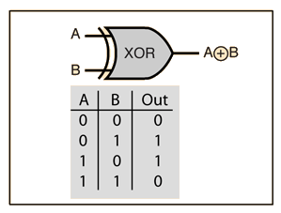
Decision Tree for XOR
(Outlook=Sunny) XOR (Wind=Weak)
Outlook
Sunny
Overcast
Rain
Exclusive OR
Wind
Wind
Wind
Strong
Weak
Strong
Weak
Strong
Weak
Yes
No
No
Yes
No
Yes

Slide 12
Decision Tree
decision trees represent disjunctions of conjunctions
Outlook
Sunny
Overcast
Rain
Humidity
Yes
Wind
High
Normal
Strong
Weak
No
Yes
No
Yes
(Outlook=Sunny ∧ Humidity=Normal)
∨ (Outlook=Overcast)
∨ (Outlook=Rain ∧ Wind=Weak)

Slide 13
When to consider Decision Trees
Instances describable by attribute-value pairs
Target function is discrete valued
Disjunctive hypothesis may be required
Possibly noisy training data
Missing attribute values
Examples:
  Medical diagnosis
  Credit risk analysis
  Object classification for robot manipulator (Tan 1993)

Slide 14
Top-Down Induction of Decision Trees ID3
A ← the “best” decision attribute for next node
Assign A as decision attribute for node
For each value of A create new descendant
Sort training examples to leaf node according to
the attribute value of the branch
If all training examples are perfectly classified (same value of target attribute) stop, else iterate over new leaf nodes.

Slide 15
Which attribute is best?
[29+,35-]
A₁=?
A₂=?
[29+,35-]
G
H
L
M
[21+, 5-]
[8+, 30-]
[18+, 33-]
[11+, 2-]

Slide 16
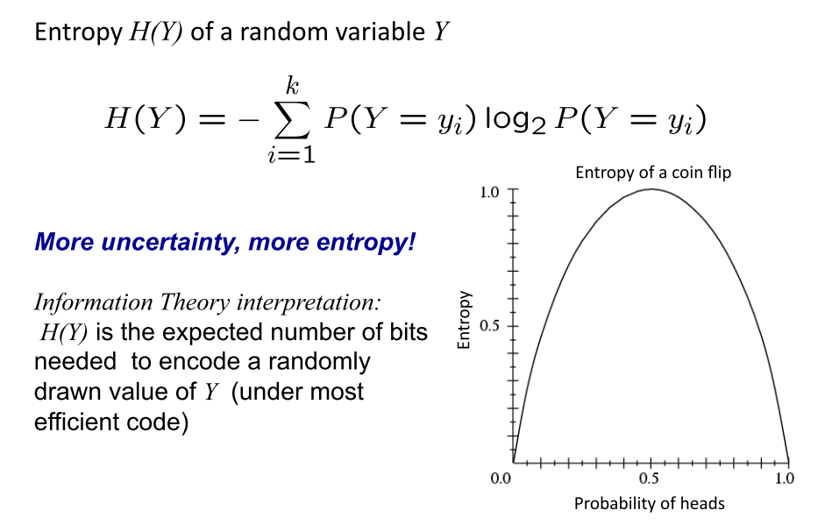
Entropy
There is an increase in entropy for any system undergoing an irreversible process.

Slide 17
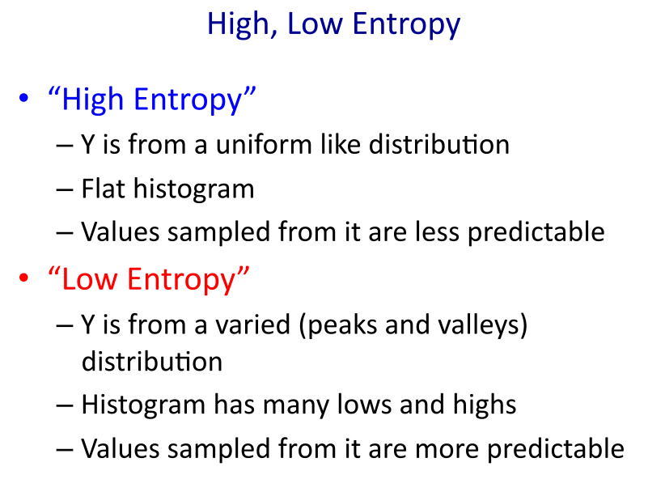
Entropy

Slide 18
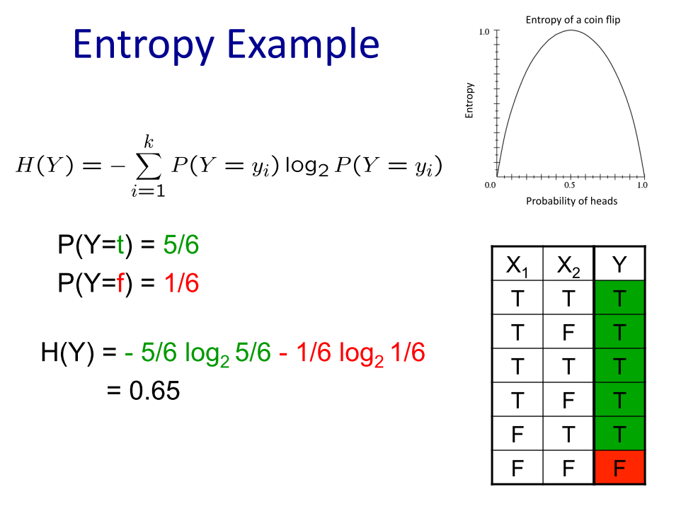
Entropy

Slide 19
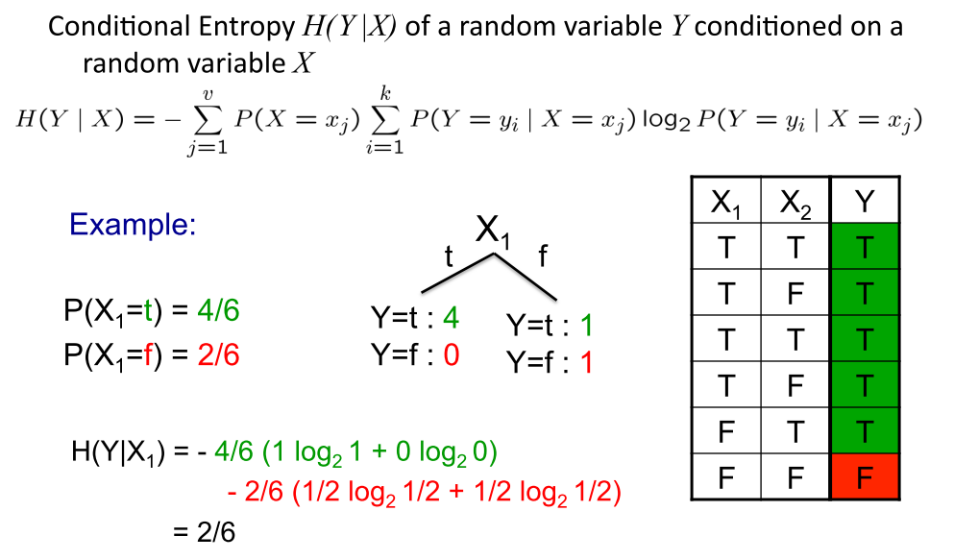
Conditional Entropy

Slide 20
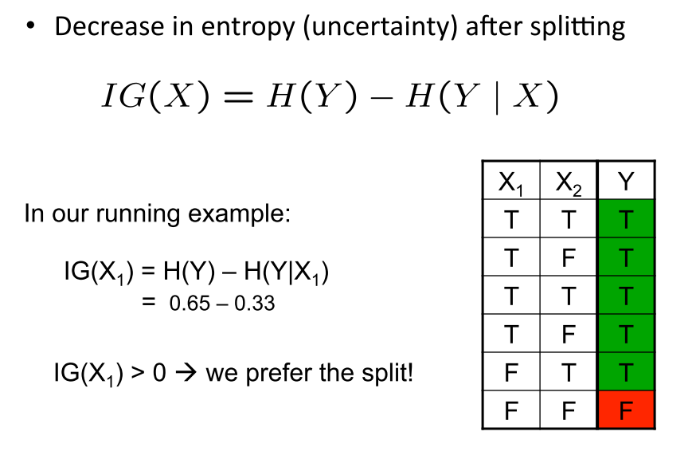
Information Gain

Slide 21
Training Examples
Day
Outlook
Temp.
Humidity
Wind
Play Tennis
D1
Sunny
Hot
High
Weak
No
D2
Sunny
Hot
High
Strong
No
D3
Overcast
Hot
High
Weak
Yes
D4
Rain
Mild
High
Weak
Yes
D5
Rain
Cool
Normal
Weak
Yes
D6
Rain
Cool
Normal
Strong
No
D7
Overcast
Cool
Normal
Weak
Yes
D8
Sunny
Mild
High
Weak
No
D9
Sunny
Cold
Normal
Weak
Yes
D10
Rain
Mild
Normal
Strong
Yes
D11
Sunny
Mild
Normal
Strong
Yes
D12
Overcast
Mild
High
Strong
Yes
D13
Overcast
Hot
Normal
Weak
Yes
D14
Rain
Mild
High
Strong
No

